Slide 1

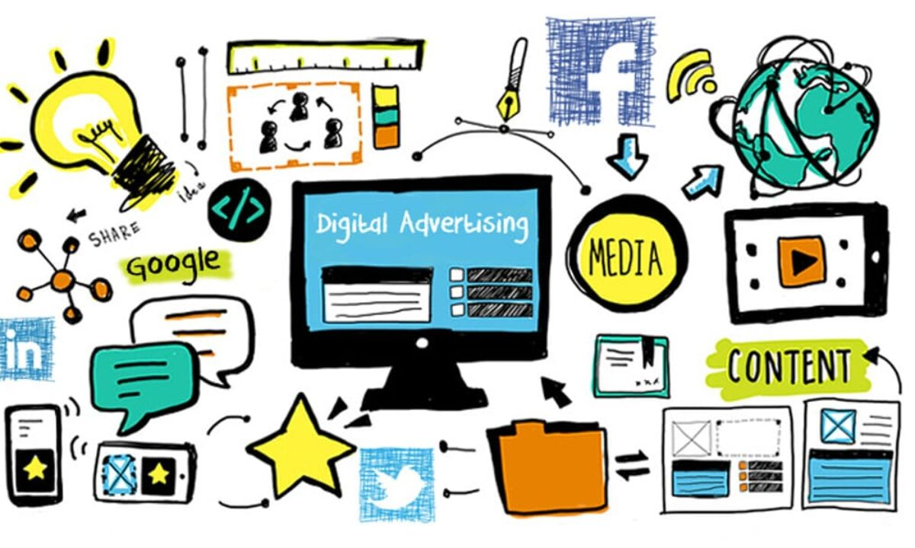
Meta Advertisement Revenue
Presented by:
Soham Ghorpade

Slide 2

The Impact of Online Advertisement on Building a Brand and on Purchase Intention
Goal: The study examines the impact of online advertisements on building a brand and on purchase intention.
Dataset: Sample consists of 389 respondents were males and females, ages 18-50 years old from different regions in the Philippines. An online survey was adapted by the researchers. Using this method, the researchers asked the pertinent questions about their research. The sample size for this study was 389 people. The researchers used a Raosoft Sample size calculator to determine the required sample size of respondents. Following that, the researchers held an online session with their statistician to conduct a validity and reliability test before distributing the questionnaires.
Methodology: Descriptive Correlation : Descriptive correlational analysis is to describe relationships between variables, it helps researchers in determining the relationship between the variables in their study. Mathematical or Statistical Treatment of Data [Mean and Standard Deviation]: The researchers used standard deviation to determine the distance between individual data values and the mean value. Using various factors such as electronic word of mouth, online communities, and online advertising, multiple regression was calculated to predict purchase intention. regression equation was found (F(3, 385) = 77.305, p < 0.00), with adjusted R² of 0.370. The respondents' predicted purchase intention is equal to 1.159 + 0.207EWOM + 0.169OC + 0.301OA, where EWOM is the electronic word of mouth, OC is online communities, and OA is an online advertisement. These factors were found to have significant positive effect on purchase intention.
Results: The survey predicted brand loyalty increases by 0.234 for every one unit increase in electronic word of mouth and purchase intention increases by 0.169 for every one unit increase in online communities and 0.301 for every one unit increase in online advertisement. With age profile of respondents, the results showed that most of the respondents are from 18-26 years old, witha percentage of 93.32%. Followed by 35-42 years old with a percentage of 3.17%, 43-50 years old with a percentage of 2.12%, and lastly, 27-34 years old with a percentage of 1.59%.
Article Link: https://al-kindipublisher.com

Slide 3

Sentiment Analysis to Measure Celebrity Endorsement’s Effect using Support Vector Machine Algorithm
Goal: Measure how celebrity endorsement affects the sales of the product
Dataset: The dataset is extracted from YouTube user's comments and tweets from Twitter that related to the topic using the open-source tools and then put together in a file with csv format. Then the comments that have been collected are separated according to the date - before and after February 18, 2018. Once the dataset is generated, then labelled the comments based on their sentiments. The data label includes positive, negative, and neutral. The total number of comments taken into consideration are 458[before endorsement] and 737[after endorsement].
Methodology: Model Conceptual In this study, sentiment analysis was created to investigate the effect of celebrity endorsement on public sentiment using SVM and had an evaluation phase that included scenario testing. Research Methodology: It is divided into three stages: problem and solution identification stage, sentiment analysis stage using SVM, result analysis and conclusion stag. First data is collected and then pre-processing is done like cleaning, labelling, and classification. Feature extraction is carried out and then data is feed to the Support Vector Machine [SVM] algorithm.
Results: SVM algorithm predicted the change in Sentiment proportions before and after celebrity endorsement. Sentiment proportions before celebrity endorsement were 71% neutral, 17% negative, and 12% positive. While the details of sentiment proportions after celebrity endorsement were 40% neutral, 42% negative, and 18% positive.
Article Link: https://core.ac.uk

Slide 4

A Security Analysis of the Facebook Ad Library Laura Edelson, Tobias Lauinger, and Damon McCoy New York University
Goal: Security analysis of Facebook’s Ad Library for ads about social issues, elections or politics.
Present an algorithm for detecting advertisers who may be engaging in undeclared coordinated activity.
Show how Facebook Ad’s library has both design and implementation flaws.
Suggestions on improvements to the security of political advertising transparency on Facebook and other platforms.
Dataset: Facebook’s Ad Library API to retrieve all (new) ads from that week’s batch of pages. Dataset contains 3,685,558 ads created during the study period. Total Ads : 3,685,558 Page: 122,141 Disclosures: 58,494 Total Spend: $ 623,697,453 – $ 628,461,938
Methodology: Made use of a simhash algorithm. Simhashing is a hashing technique that generates hash values such that the difference between two hashes is equal to the Hamming distance between the two texts. Then they have used 64-bit fingerprint with a k of 3, as suggested by Manku, Jain, and Sarma, and validate it manually. Higher k values indicate fuzzier matches, while lower k values indicate closer matches. They have also found out the bugs that led to unretrievable ads from Facebook API.
Results: The majority (54.6%) of all Ad Library pages with ads do not include a disclosure string. 60,323 pages spent less than $ 100. There were also 11,139 pages with undisclosed spend under $ 100 that eventually disclosed other ads. There where almost 25,000+ pages accounting for $ 1 million that did not disclosed ads. China Xinhua News spent at least $ 16,600 for 51 undisclosed political ads. Incorrectly attributed ads and ad spending is approximately equal to $ 100 million (98.2)
Article Link: https://ieeexplore.ieee.org

Slide 5

Social Media Based Personalized Advertisement Engine
Goal: Identify the most appropriate advertisement for each user
Dataset: To gather data from twitter used JAX-RX (Java API for RESTful Web Services), then get all the tweets from users account and send those tweets to the sentiment analysis web services to get the positive tweets to the system
Methodology: To achieve this goal, they used semantic analysis and ontology mapping, as well as an advertisement classification mechanism in AdSeeker advertisement engine. engine built using JAVA JAXRX Restful API web services, Apache Jena which is used to connect and query with an ontology, hibernate to deal with database, MySQL Server used as the database, sentiment analysis using Naïve Bayers and used NLTK libraries. To demonstrate advertisement engine, they have used PHP web application with Codeigniter framework. The research is based on user preference-based advertisement pushing mechanism, which they had to develop ontology domains using Protégé software which classifies the data. Example:- Technology :Top Category, Mobile Phone: Product Type ,Apple: Brand, IPhone 6s plus: Product. Implement the Advertisement Fetcher Algorithm to identify how many advertisements we want to fetch from the database and then run Advertisement classifier algorithm gets relevant advertisements from the database.
Results: the new features of proposed system Advertisers can categorize the advertisement, Categorization according to the person, Personalized advertisements, Self-updating character profile. The proposed system provides around 90% relevant advertisements to the user, according to the results of 20 participants. Article Link: https://ieeexplore.ieee.org

Slide 6

Analyzing the Impact and Accuracy of Facebook Activity on Facebook’s Ad-Interest Inference Process
Goal: To Analyse the accuracy and impact of Facebook Activity on Facebook’s Ad-Interest.
Dataset: 1) controlled experiments creating customized user accounts in Facebook[consisted of four accounts with the same demographic information: 22 years old, male, and based in Pakistan] and 2) recruiting participants through a user study.[ All participants were recruited through Amazon Mechanical Turk where they had to be at least 18 years old and have a 95% HIT (Human Intelligence Task) approval rate across at least 100 HITs.] Data collected was: 1. The first 10 ads 2. Names and links of the most recent 100 page likes, and the total number of pages liked by the participant 3. Number of activities performed since account creation and 4. Number of years since account creation Methodology: Different methods where used to perform the data analysis
Manually mapped the inferred interests in each account to a specific performed activity
Performed Pearson’s Chi-Square test to compute statistical significance between different groups. They used the Mann-Whitney U test to compare five-point Likert scale responses (for the interests rating question).
To account for the possibility of a error, all post-hoc analyses used Bonferroni's correction.
Compared the positive account’s Post Like/Love reacts activity against the negative account’s angry reacts activity.
The demographics of different accounts were purposefully kept the same (Location: Pakistan, Gender: Male, Age: 22).
Positive and negative interactions were mixed together and Unliking Pages and Hiding Posts were taken into consideration.
Results: Found a total of 187 inferred interests for the positive interaction account. Around 68.98% (129/187) of such interests were relevant to planned activities. The negative interaction account had a comparable accuracy rate of 62.60% (62 out of 99 total interests correctly inferred). It was observed that 61.36% of interests inferred from the page liked activity to be relevant.
Article Link: https://anupamdas.org

Slide 7

How Machine Learning Artificial Intelligence Improves Users’ Perceptions of Facebook Ads: A Model of Personalization, Advertising Value and Purchase Intention
Goal: Improve Users’ Perceptions of Facebook using Machine Learning Artificial Intelligence
Dataset: Convenience sampling on Prolific, 750 Facebook users living in the United States responded to the survey between 11:00 p.m. on September 8, 2021, and 11:30 a.m. on September 9, 2021 EST. The final sample size was 731. 372 (50.9%) female, 351 (48%) male and 8 (1.1%) non-binary respondents. Average age was 44.79 years. The oldest group, those aged 55 and up, accounted for 33.6% of the total, with the youngest group, those aged 15 to 24, accounting for 13.7%. 67.3% of the 731 respondents had a college degree, while 68% worked either part-time or full-time. Finally, 52.9% of respondents reported having a household income of $60,000 or more.
Methodology: An integrated model was made up of adverting value, personalization, cognitive and affective factors and purchase intention. integrated model was established to study the relationships between nine variables in Facebook’s machine learning-powered advertising platforms. Purchase intent, advertising value, informativeness of advertisements, credibility of advertisements, entertaining quality of advertisements, irritating quality of advertisements, advertising personalization, active use of Facebook, and finally open use of Facebook were the nine variables. To assess purchase intent, a five-point Likert scale was used. Each of the three statements was rated by respondents based on their level of agreement (1 = strongly disagree; 2 = disagree; 3 = neither agree nor disagree; 4 = agree; 5 = strongly agree) and The three statements were:
• I would consider purchasing goods or services with advertisements onFacebook.
• I intend to purchase goods or services with advertisements on Facebook.
• I would probably buy goods or services with advertisements on Facebook.
Results: The integrated model discovered relationships between advertising personalization, active use of Facebook, open use of Facebook, informativeness, credibility, entertainment, irritation, advertising value, and purchase intention, implying that machine learning artificial intelligence plays a critical role in making Facebook advertising effective from a commercial standpoint.
Article Link: https://etd.ohiolink.edu

Slide 8
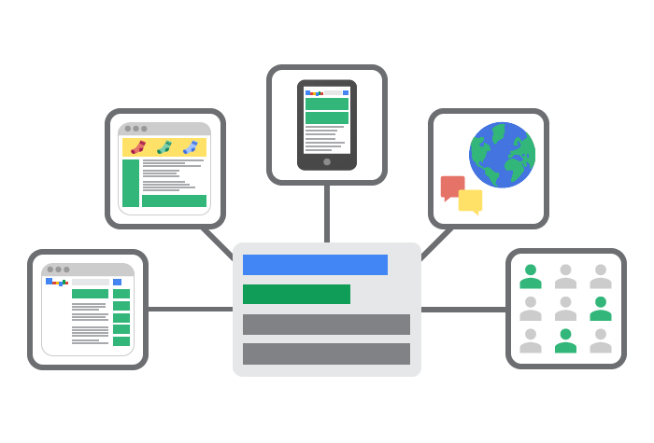
Business Intelligence Model to Analyze Social network Advertising
Goal: Perform the analysis of user exposure to online advertising in Facebook and find relevant insights.
Dataset: 20M URLs from which more than 14M were unique ads from 140K unique advertisers delivered to more than 5K users between October 2016 and May 2018. Used FDVT: Data Valuation Tool for Facebook users to gain the data.
Methodology: The URLs were divided into four groups based on how they redirected users to the landing page: (1) URLs that redirect users to a domain other than Facebook but are not performed by FB (38,102 URLs), (2) URLs that redirect users to a domain other than Facebook but are performed by FB (10,948,398 URLs), (3) internal Facebook URLs redirecting users to Facebook Pages (1,807,560 URLs), and (4) the remaining internal Facebook URLs (1,578,571 URLs). They created a simple Python module that disables the Transport Layer Security (TLS) requirement in order to obtain the Top-Level Domain (TLD) associated with a given URL. They quantified the exposure of users to ads, the exposure of users to advertisers, analyse how the interests is assigned to users and they computed engagement of FB users who received ads Results: The paper's first finding is that on average, FB users are exposed to 70 ads and 22 advertisers each week. 8.37% of users are systematically exposed to a greater portion of ads. only 22.76% of the assigned ad preferences are related to the ads delivered to the users.
Article Link: https://ieeexplore.ieee.org

Slide 9

How Algorithms Shape the Distribution of Political Advertising: Case Studies of Facebook, Google, and TikTok
Goal: How to improve disclosure of information so that the public can hold platforms and political advertising agencies responsible.
Dataset: Generated data with 850,000 ads on Facebook, Google, and YouTube and 2,7 million political videos on TikTok. For advertisements, they gathered information on who sponsored them, what specific targeting parameters and audience characteristics were used to distribute them, and so on as well as their reach in terms of impressions and the associated cost.
Google: 117,607 ads: 490 advertisers (83% of political ads in the specified period)
TikTok : 2,690,923 videos Over 61,000 creators
Facebook: 749,556 ads : 803 advertisers (65% of political ads in the specified period) Methodology: They begin by calculating the frequency of political advertisements on the platforms. then calculated the number of impressions for political advertisements on Facebook, Google, and YouTube, as well as the cost to place this content. In TikTok dataset, they collect the number of views for videos produced by political influencers and videos containing political hashtags. Using the three analytical criteria, determined whether the data provided by the online platforms adequately explains the platforms' decisions and algorithms.
Results: They assessed what the platform disclosures might reveal to the public about their role in the distribution and moderation of political advertising.
Article Link: https://arxiv.org

